Slide 1
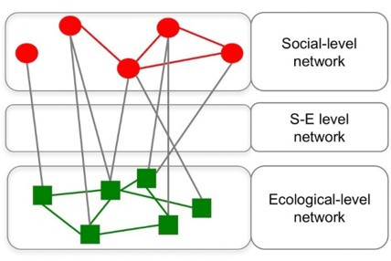
How do we extend SNA methods?

Slide 2
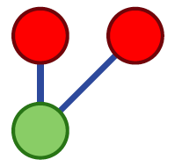
Minimal social ecological configurations (’building blocks’ or ’motifs’)
A manageble level of complexity
Can be linked to different governance challenges and outcomes
Bodin, Ö. and Tengö, M. (2012) “Disentangling intangible social-ecological systems” Global Environmental Change

Slide 3
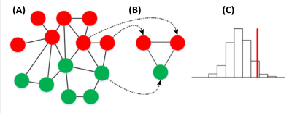
Three steps approach
Create the network (empirics)
Focus on certain theoretically important building blocks (here: competitors that collaborate)
Are they enhanced/suppressed?

Slide 4
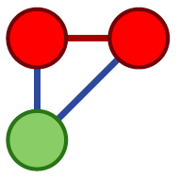
Common pool resource management
Resource competition without communication
“Race to the bottom”
Resource competition with communication
Possibility for joint agreements on resource regulation

Slide 5
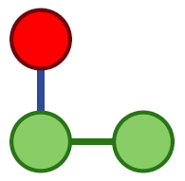
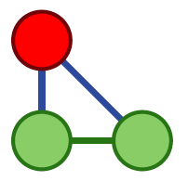
Internalize ecologial externatities (”scale (mis)match”)
Externalities
Lack of incentives to manage both resources as a ecosystem
Tight feedback
Incentives to manage as a ecosystem

Slide 6
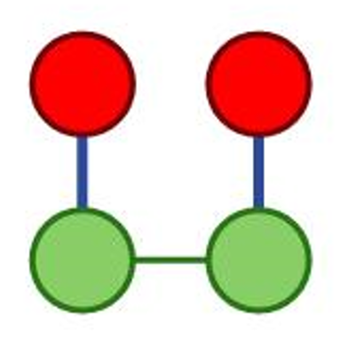
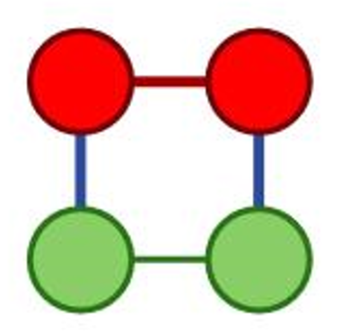
Social-ecological connectivity alignment (“fit”)
Misalignment, ecological interactions are not met by social interactions
Good alignment

Slide 7
Two cases – comparative approach
One “unsuccessful” (overfishing, decline of fish, no action to change current practices)
One “successful” (conservation of forest patches in spite of increased population and pressure for farming etc.)
Bodin et al. (2014) “Conservation success as a function of good alignment of social- and ecological structures and processes” Conservation Biology

Slide 8
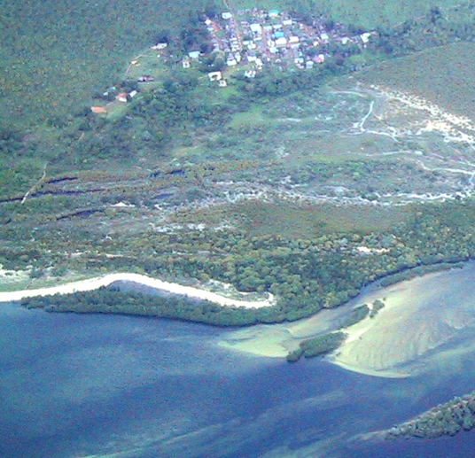
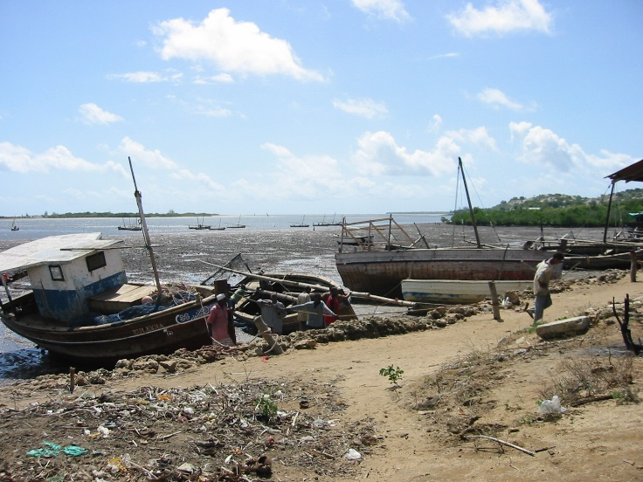
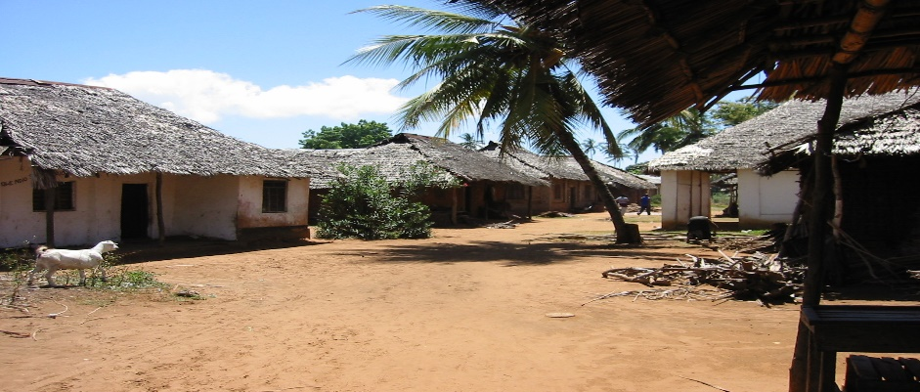
Study area #1: Small-scale fishery in east Africa
Fishery dependent
“Self-managed” village
Overfishing
Significant fishermen groups

Slide 9
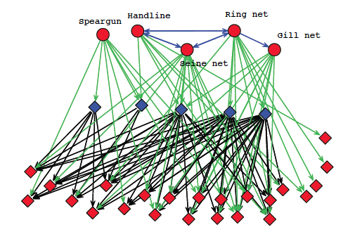
The social-ecological network
Bodin et al (2014). Conservation Success as a Function of Good Alignment of Social and Ecological Structures and Processes. Conservation Biology

Slide 10
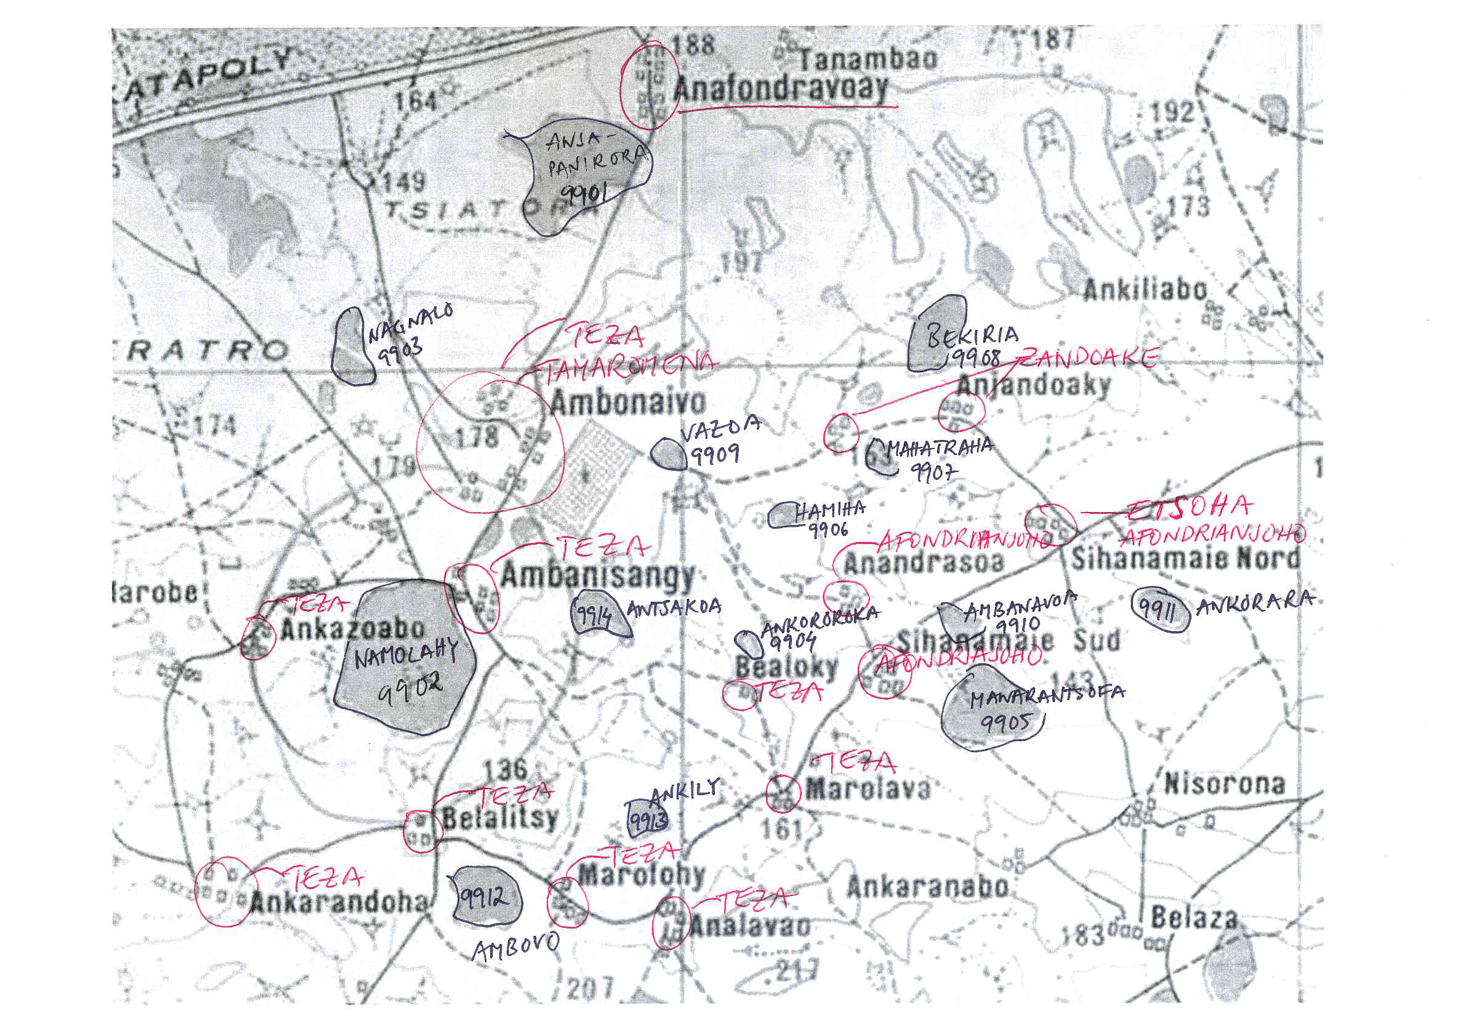
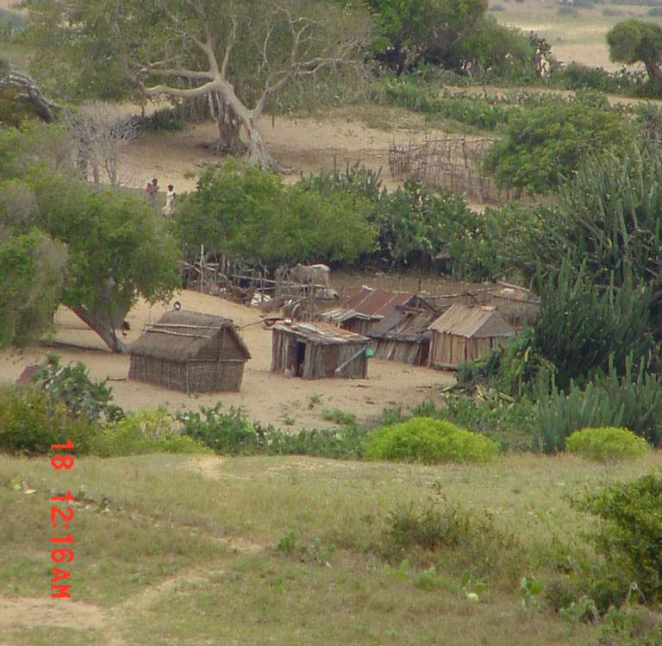
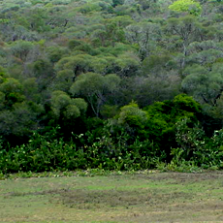
Study area #2: Forests patches and clans in Madagascar
Soc-Eco links
Ownerships
Ceremony officiate, manager, neighbor
Soc-Soc links
Kinship
Agreements
Eco-Eco links
Seed dispersal
Notes:
Social–ecological Ownership Established by customary law. The owner is in charge of rule enforcement and in most cases uses the forest as
burial ground (Tengo¨ et al., 2007)
Ceremony officiate In charge of important ceremonies in the forest such as burials (Tengo¨ and von-Heland, 2011)
Appointed manager In charge of monitoring
Neighbor Has settlement or fields in proximity of forest, held accountable for forest disturbance
Social Kinship relation Based on shared ancestry, agreed kinship, or historical dependencies that is manifested in forest related ceremonies
such as burials
Ecological Seed dispersal Based on assumed regular movement of key seed disperser, Lemur catta, in the landscape (Bodin et al., 2006)

Slide 11
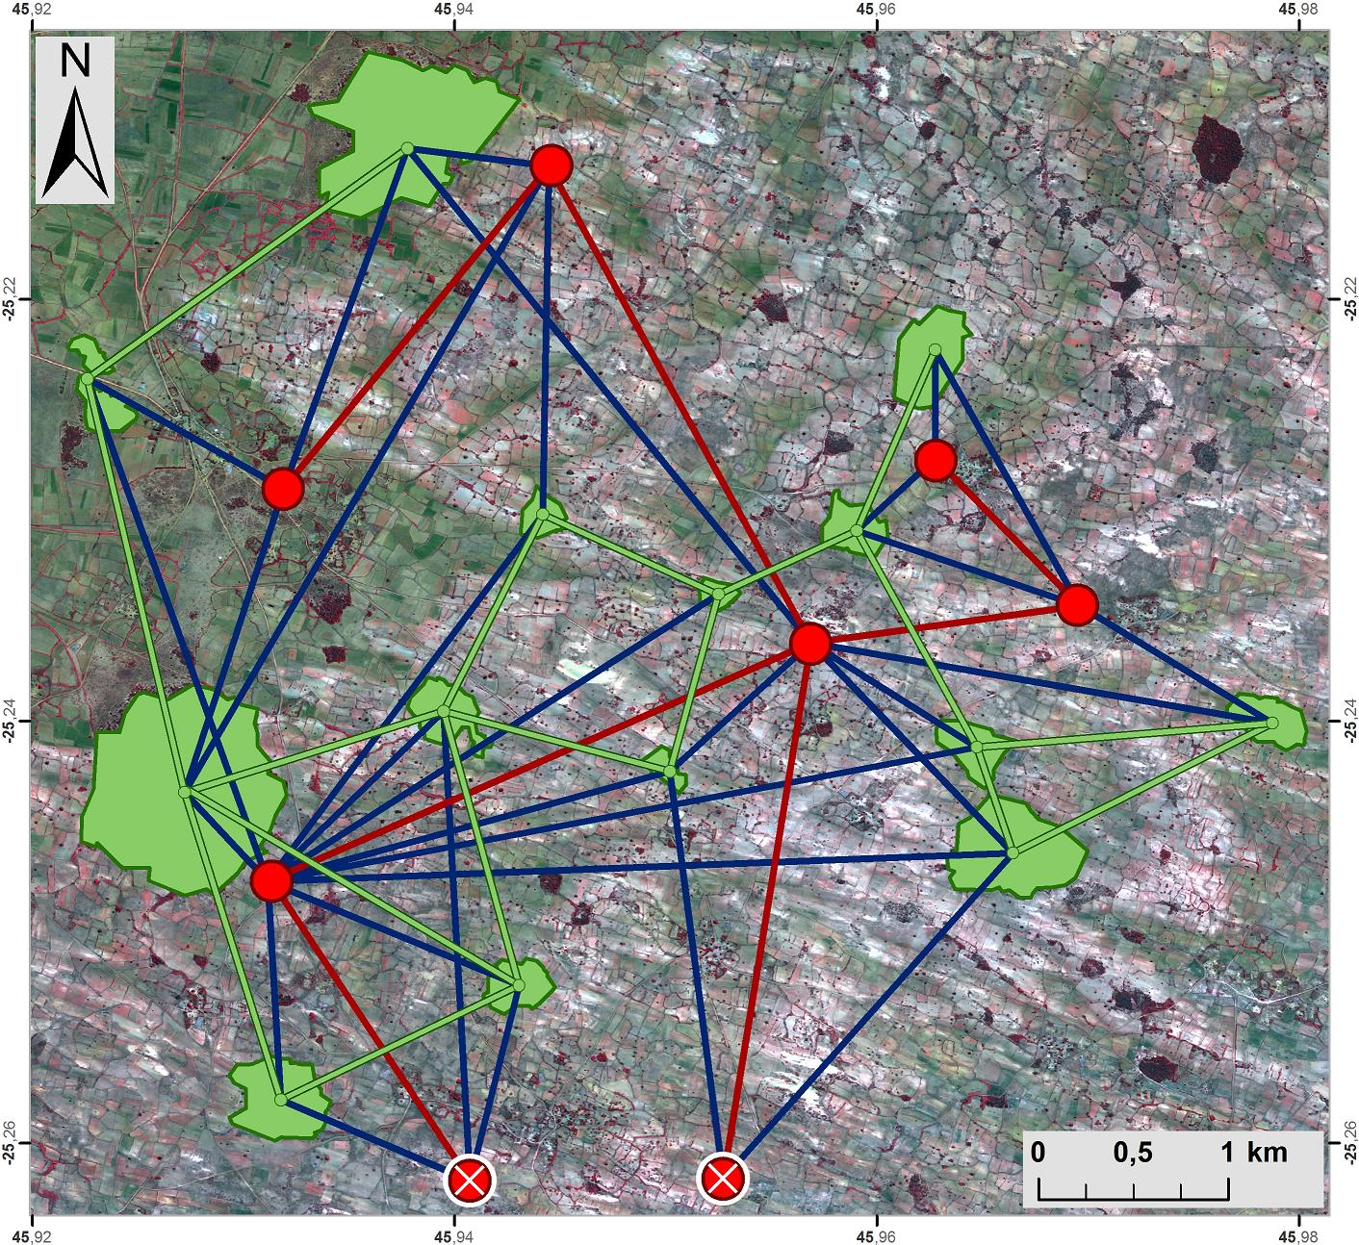
The social-ecological network
Figure by Anna Norman

Slide 12
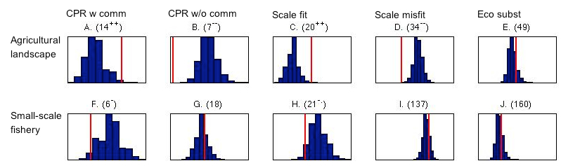
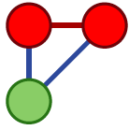
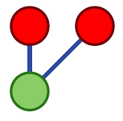
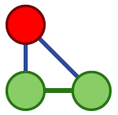
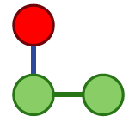
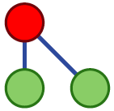
Compare frequencies

Slide 13
Common pool resources

Slide 14
Common pool resources

Slide 15
Scale fit

Slide 16
Scale fit

Slide 17
In all – good alignment expectations/results

Slide 18
Exercise
See separate lab instructions for SEN Analyzer

